Slide 1

RS485 serial bus communication with.NET Core, Raspberry PI and Arduino
Marco Parenzan

Slide 2
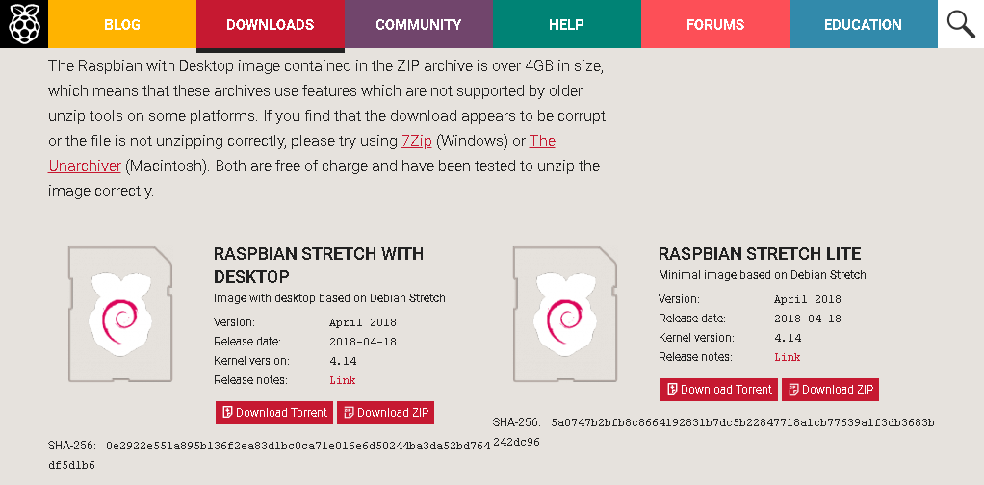
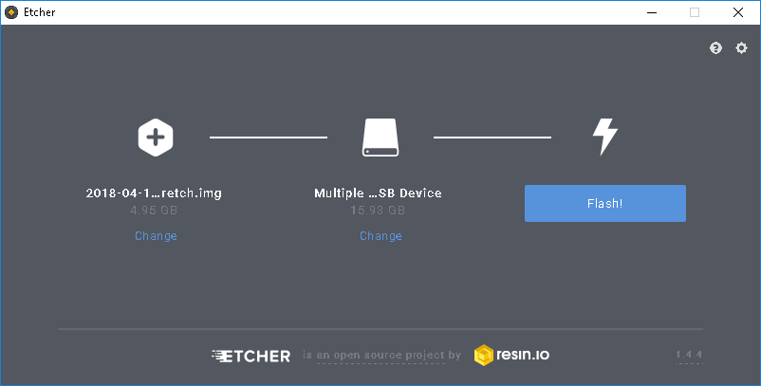
Preparing Raspberry Pi for the first time
Download last raspbian image from https://www.raspberrypi.org/downloads/raspbian/
Extract the img file from the zip
Write image to the SD card with Etcher
download etcher from https://etcher.io/

Slide 3


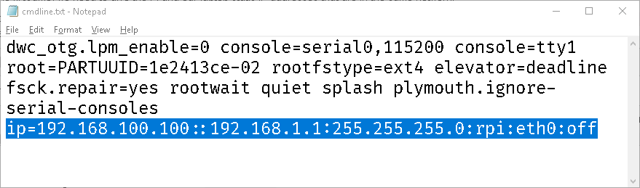
Configuring SD card to connect to the RPI
From the Windows Explorer you see a couple of drives:
Boot, the boot partition, accessible from windows
Usb Drive, the linux partition
Identify the cmdline.txt file
Choose a private class to connected your PC with RPI via Ethernet cable (ex. 192.168.100.100)
ip=192.168.100.100::192.168.1.1:255.255.255.0:rpi:eth0:off
Configure this on cmdline.txt

Slide 4
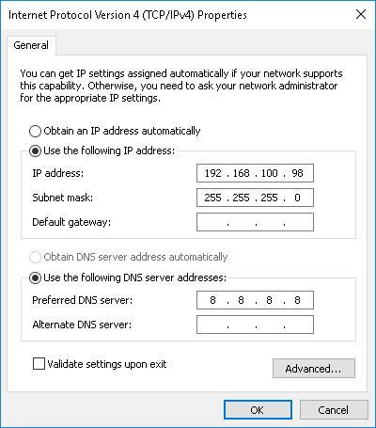
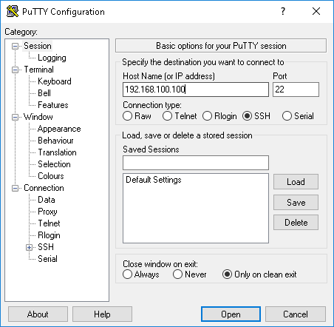
Configure your Ethernet to connect to the RPI for the first time (make equivalent chooses on Linux or Mac)
...and then download and install PuTTY (https://www.putty.org/) to connect

Slide 5
Entering Raspberry PI from the console for the first time
Connect as pi|raspberry (standard user and password) for the first time

Slide 6

Configuring WiFi on the Raspberry
https://www.raspberrypi.org/documentation/configuration/wireless/wireless-cli.md
Have a WiFi with WPA/WPA2 with SSID and a PSK
Open wifi configuration file
sudo nano /etc/wpa_supplicant/wpa_supplicant.conf
Configure your wifi
Then reboot
And then you can identify your wifi ip address from the router or with the following command
sudo ifconfig

Slide 7
Installing .NET Core on Raspberry PI
Best way (thanks to Scott Hanselman tip)
https://www.hanselman.com/blog/BuildingRunningAndTestingNETCoreAndASPNETCore21InDockerOnARaspberryPiARM32.aspx
Look at the current Docker file (docker is more useful to deploy and run .NET Core more than dev)
https://github.com/dotnet/dotnet-docker/blob/master/2.1/sdk/stretch/arm32v7/Dockerfile
In general
Install all the updates
Download package (check if the last version – there is a variable for this)
Create directory
Unpack
Set global variables
Lauch with dotnet command!

Slide 8
Best practices writing code on Raspberry PI
Write code on your laptop
Test and debug on your laptop as much as you can
Commit code onto a GitHub repository
Then on the raspberry
Clone the repository
Edit source files with nano <filename>
dotnet build (from the root of the project) builds the project
Output is container in bin/Debug/netstandard2.1 folder
dotnet run lauch from the project folder
dotnet <dllname> from the output folder

Slide 9
Get the code
git clone https://github.com/marcoparenzan/RS485Communication.git
nano RS485Communication.cs

Slide 10
SerialPort.Core does not work on Linux ☹
Common issue
https://github.com/dotnet/core/issues/740
Use an open source reimplementation
Install-Package SerialPortStream -Version 2.1.4
https://github.com/jcurl/SerialPortStream

Slide 11
SerialPortStream does not work on Rpi ☹
Dependency on libnserial.so* libs
Solution
Recompile natively on RPI (https://www.raspberrypi.org/forums/viewtopic.php?t=62344)
sudo apt-get update && sudo apt-get upgrade sudo apt-get install cmake
Clone GIT source from https://github.com/jcurl/SerialPortStream
cd seriallinux
./build.sh
Set environmental variables
https://github.com/jcurl/SerialPortStream/blob/v2.x/README.md
export LD_LIBRARY_PATH=`pwd`/bin/usr/local/lib:$LD_LIBRARY_PATH
Cp all libnserial.so* into netstandard2.1 dir

